Slide 1
Online Food ordering System
B. Sai Krishna
176260

Slide 2
The online food ordering system sets up a food menu online and customers can easily place the order as per their interest. The payment can be made by cash-on-delivery system. For more secured ordering separate accounts are maintained for each user by providing them an unique ID and a password.
Problem Statement :

Slide 3
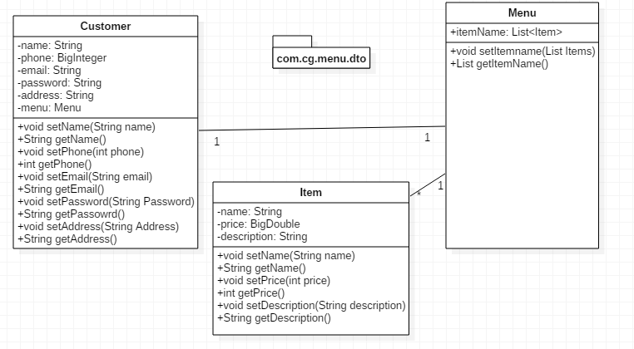
DTO:

Slide 4
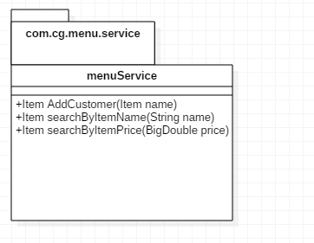
SERVICE :

Slide 5
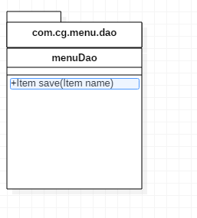
DAO :

Slide 6
B. Sai Krishna 176260
Thank You

